Slide 1
Ratings Prediction PPT
A PowerPoint presentation containing problem statement and understanding, EDA steps and visualizations, Steps and assumptions used to complete the project, model dashboard, finalized model, and conclusion.

Slide 2
Problem Statement
We have a client who has a website where people write different reviews for technical products. Now they are adding a new feature to their website i.e. The reviewer will have to add stars(rating) as well with the review. The rating is out 5 stars and it only has 5 options available 1 star, 2 stars, 3 stars, 4 stars, 5 stars. Now they want to predict ratings for the reviews which were written in the past and they don’t have a rating. So, we have to build an application which can predict the rating by seeing the review.

Slide 3
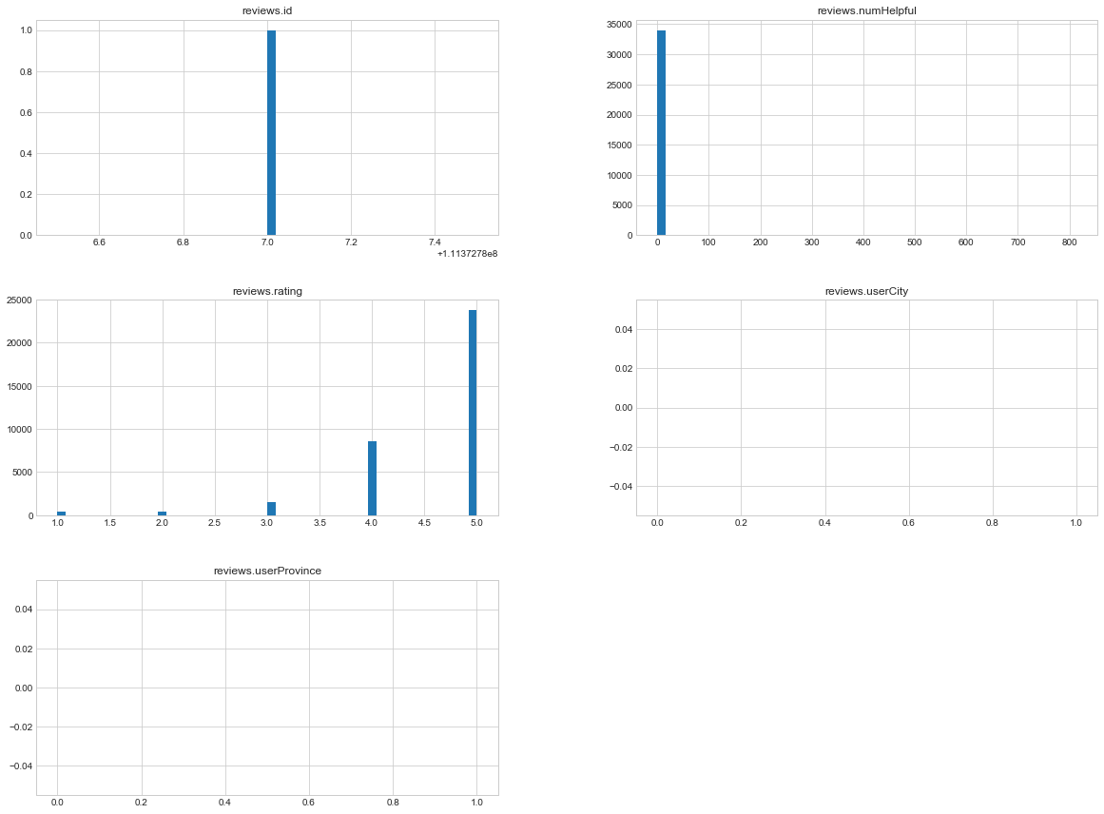
Data Visualization

Slide 4
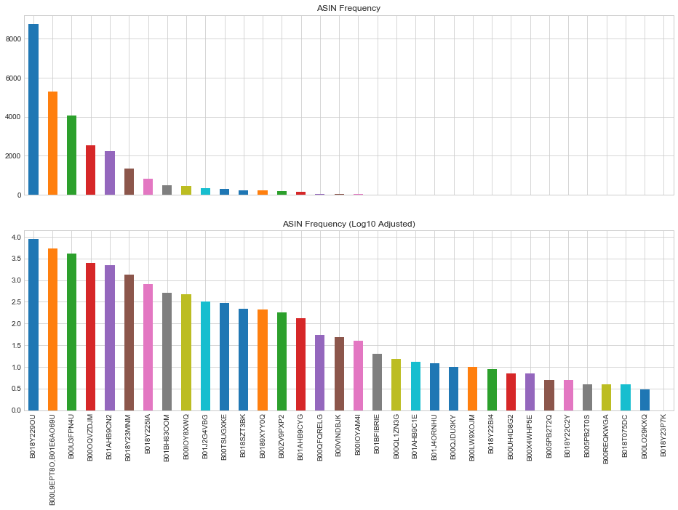

Slide 5
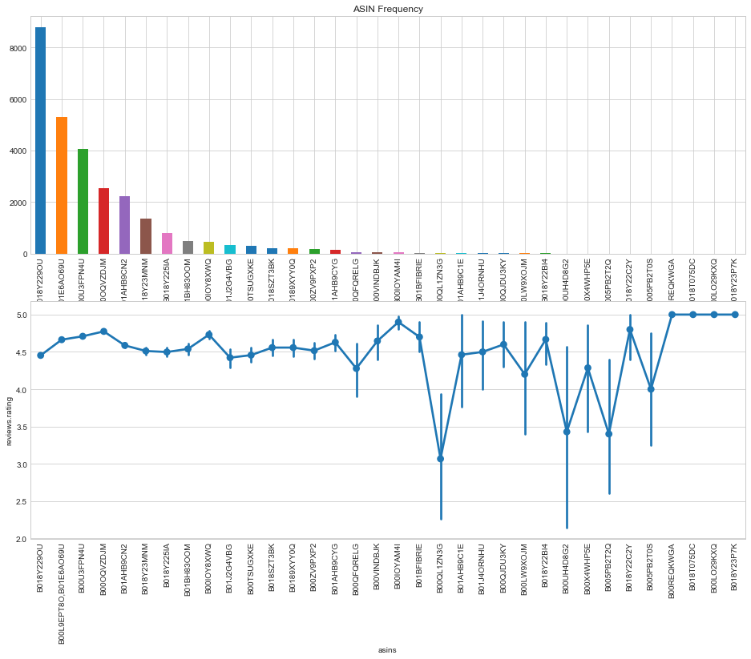

Slide 6
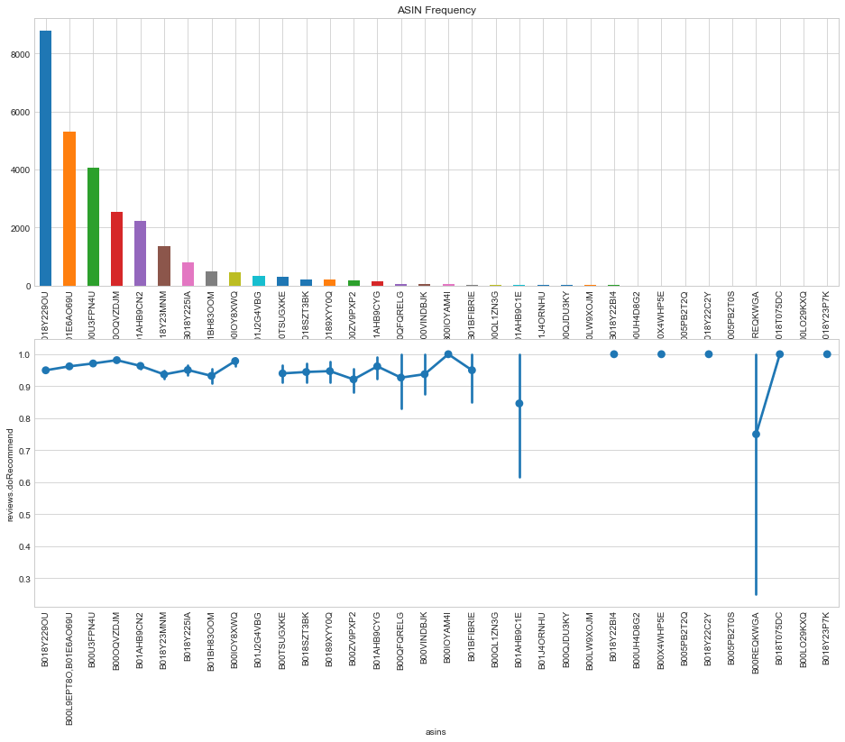

Slide 7
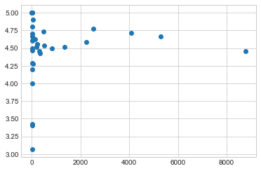

Slide 8
Model’s Training
Model’s used for the classification and regression

Slide 9
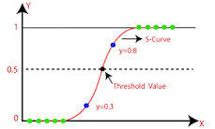
1. Logistic Regression Model –
Logistic regression is one of the most popular Machine Learning algorithms, which comes under the Supervised Learning technique. It is used for predicting the categorical dependent variable using a given set of independent variables. Logistic regression predicts the output of a categorical dependent variable.
Logistic regression is a supervised learning classification algorithm used to predict the probability of a target variable. The nature of target or dependent variable is dichotomous, which means there would be only two possible classes.

Slide 10

2. Support Vector Machine Classifier Model -
Support Vector Machine or SVM is one of the most popular Supervised Learning algorithms, which is used for Classification as well as Regression problems. However, primarily, it is used for Classification problems in Machine Learning.
The goal of the SVM algorithm is to create the best line or decision boundary that can segregate n-dimensional space into classes so that we can easily put the new data point in the correct category in the future. This best decision boundary is called a hyperplane.

Slide 11
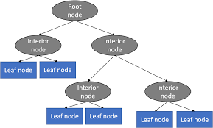
3. DecisionTreeRegressor Model -
Decision Tree is a decision-making tool that uses a flowchart-like tree structure or is a model of decisions and all of their possible results, including outcomes, input costs, and utility.
Decision-tree algorithm falls under the category of supervised learning algorithms. It works for both continuous as well as categorical output variables.
The branches/edges represent the result of the node and the nodes have either:
Conditions [Decision Nodes]
Result [End Nodes]

Slide 12
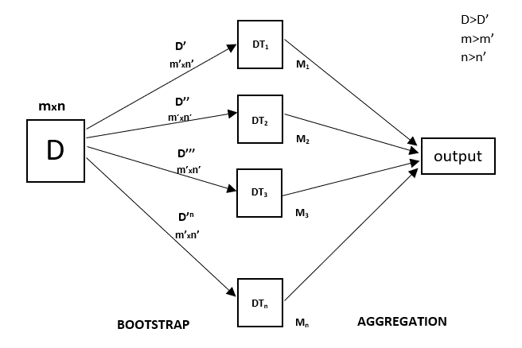
4. RandomForestRegressor Model -
A Random Forest is an ensemble technique capable of performing both regression and classification tasks with the use of multiple decision trees and a technique called Bootstrap and Aggregation, commonly known as bagging. The basic idea behind this is to combine multiple decision trees in determining the final output rather than relying on individual decision trees.
Random Forest has multiple decision trees as base learning models. We randomly perform row sampling and feature sampling from the dataset forming sample datasets for every model. This part is called Bootstrap.

Slide 13
Conclusion
Looks like all the models performed very well (>90%), and we will use the Support Vector Machine Classifier since it has the highest accuracy level at 93.94%

